Slide 1

UNIT – II INTRODUCTION TO DEEP LEARNING
Final Year BTECH
Subject : Deep Learning (PE3)

Slide 2
Unit II : Contents
Introduction to Deep Learning
Introduction to Deep learning, Architecture, Multilayer Perceptron (MLP), Training MLP, Chain Rule, Back-propagation, Optimization Methods, Feedforward Neural Network, Examples of Deep Learning.

Slide 3
Introduction to Deep learning, Architecture, Multilayer Perceptron (MLP), Training MLP, Chain Rule
Sources:
Machine learning with neural networks An introduction for scientists and engineers, Bernhard Mehlig
Final Year BTECH
Subject : Deep Learning (PE3)

Slide 4
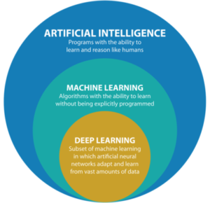
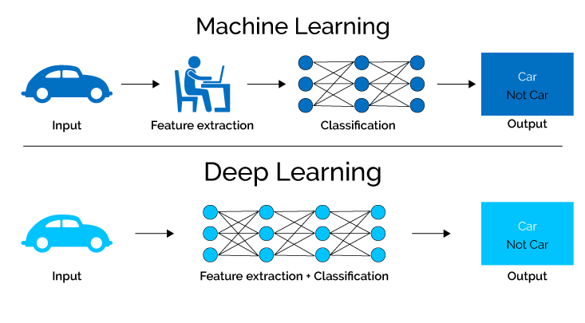
Introduction to Deep learning
Deep Learning comes under the artificial intelligence umbrella, either alongside machine learning or as a subset.
The difference is that machine learning uses algorithms developed for specific tasks.
Deep learning is more of a data representation based upon multiple layers of a matrix, where each layer uses output from the previous layer as input.
Source (Figure) : https://semiengineering.com/deep-learning-spreads/

Slide 5
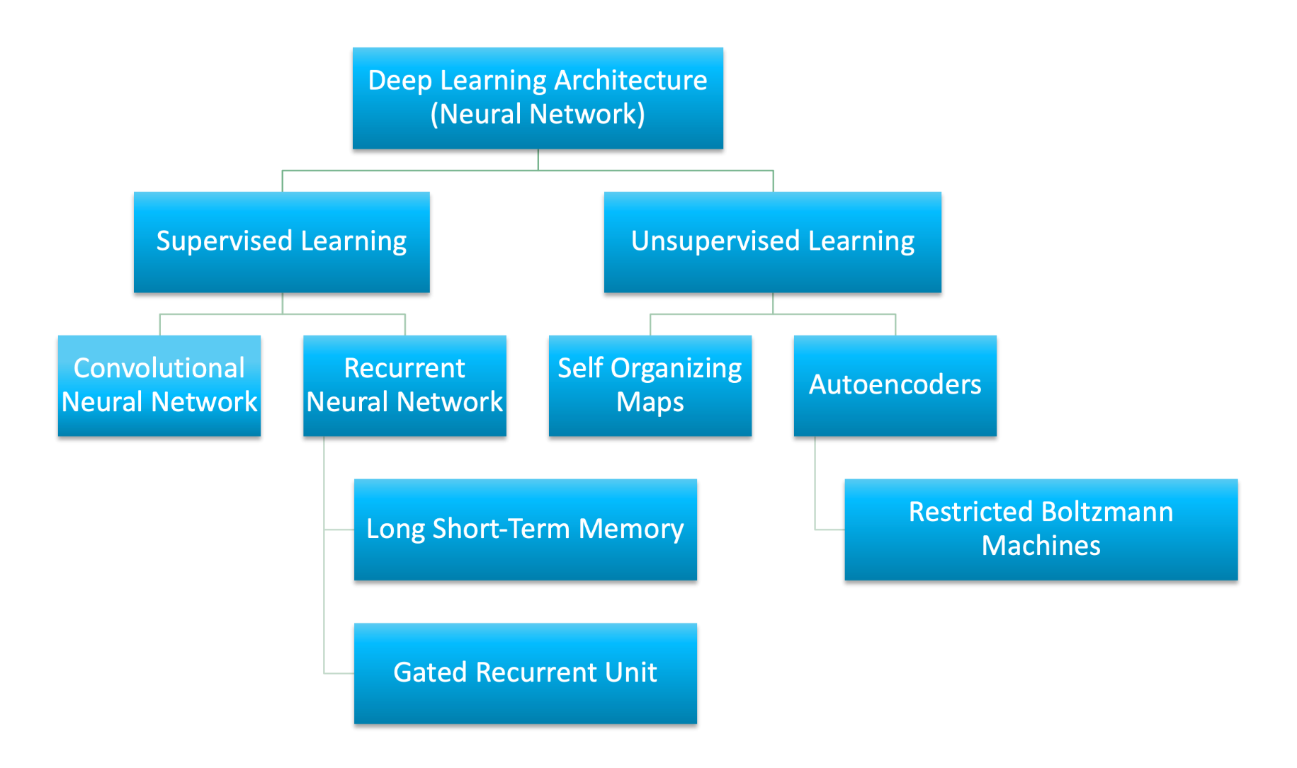
Deep learning Architecture
Source (Figure) : https://developer.ibm.com/developer/default/articles/cc-machine-learning-deep-learning-architectures/images/DL-arch.png

Slide 6
Deep Neural Network
ANN is a deep feed-forward neural network as it processes inputs in the forward direction only. Artificial Neural Networks are capable of learning non-linear functions. The activation function of ANNs helps in learning any complex relationship between input and output.
RNN is designed to overcome the looping constraint of ANN in hidden layers. Deep recurrent networks are capable of solving problems related to audio data, text data, and time-series data. Recurrent neural networks capture sequential information available in the input data. RNN works on parameter sharing.
CNN based models in Deep Neural Networks are used in video and image processing. Filters or kernels are the building blocks of CNN. By using conventional operations kernels extract relevant and correct features from the input data.
https://www.jigsawacademy.com/blogs/ai-ml/deep-neural-network/

Slide 7
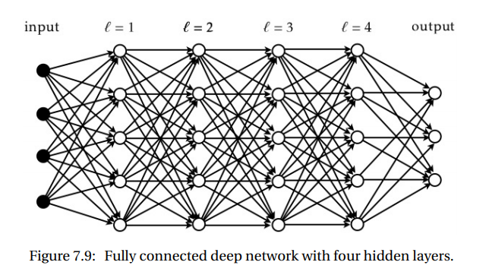
Deep Neural Network
Machine learning with neural networks An introduction for scientists and engineers, Bernhard Mehlig (page no.130)

Slide 8
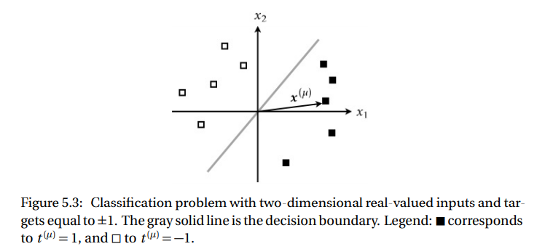
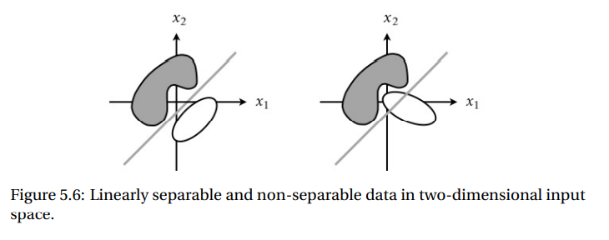
Introduction to Deep learning
Why it is sometimes necessary to have a hidden layer?
In order to solve problems that are not linearly separable.
Machine learning with neural networks An introduction for scientists and engineers, Bernhard Mehlig (page no.91-123)

Slide 9
Difference between Machine Learning and Deep Learning
Machine Learning | Deep Learning
Works on small amount of Dataset for accuracy. | Works on Large amount of Dataset.
Dependent on Low-end Machine. | Heavily dependent on High-end Machine.
Divides the tasks into sub-tasks, solves them individually and finally combine the results. | Solves problem end to end.
Takes less time to train. | Takes longer time to train.
Testing time may increase. | Less time to test the data.
https://www.geeksforgeeks.org/introduction-deep-learning/#:~:text=Deep%20Neural%20Network%20%E2%80%93%20It%20is,is%20multi%2Dlayer%20belief%20networks.

Slide 10
Difference Between Neural Network And Deep Neural Network
The Deep Neural Network is more creative and complicated than the neural network. Deep Neural Network algorithms can recognize sounds and voice commands, make predictions, think creatively, and do analysis. They act like the human brain.
Neural networks give one result. It can be an action, a word, or a solution. On the other hand, Deep Neural Networks provides solutions by globally solving problems based on the information given.
Specific data input and algorithm is required for a neural network, whereas Deep Neural Networks are capable of solving problems without a specific data amount.
https://www.jigsawacademy.com/blogs/ai-ml/deep-neural-network/

Slide 11
Multilayer Perceptron (MLP)
A multilayer perceptron (MLP) is a class of feedforward artificial neural network (ANN).
The term MLP is used ambiguously, sometimes loosely to any feedforward ANN, sometimes strictly to refer to networks composed of multiple layers of perceptrons (with threshold activation);
Multilayer perceptrons are sometimes colloquially referred to as "vanilla" neural networks, especially when they have a single hidden layer.
An MLP consists of at least three layers of nodes: an input layer, a hidden layer and an output layer. Except for the input nodes, each node is a neuron that uses a nonlinear activation function.
MLP utilizes a supervised learning technique called backpropagation for training. Its multiple layers and non-linear activation distinguish MLP from a linear perceptron.
It can distinguish data that is not linearly separable
The multilayer perceptron (MLP) is used for a variety of tasks, such as stock analysis, image identification, spam detection, and election voting predictions.
https://en.wikipedia.org/wiki/Multilayer_perceptron

Slide 12
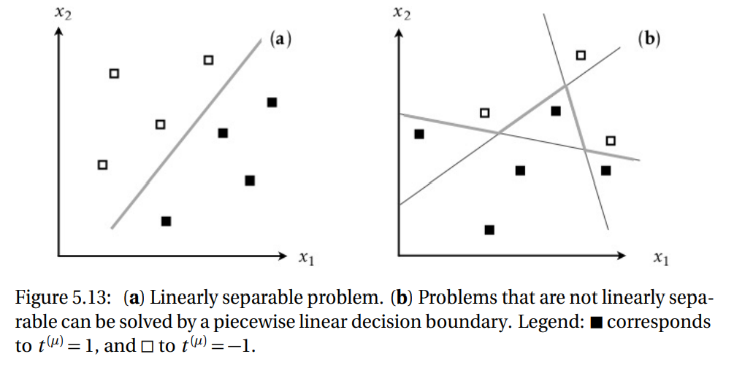
Multilayer Perceptron (MLP)
Machine learning with neural networks An introduction for scientists and engineers, Bernhard Mehlig (page no.92)

Slide 13
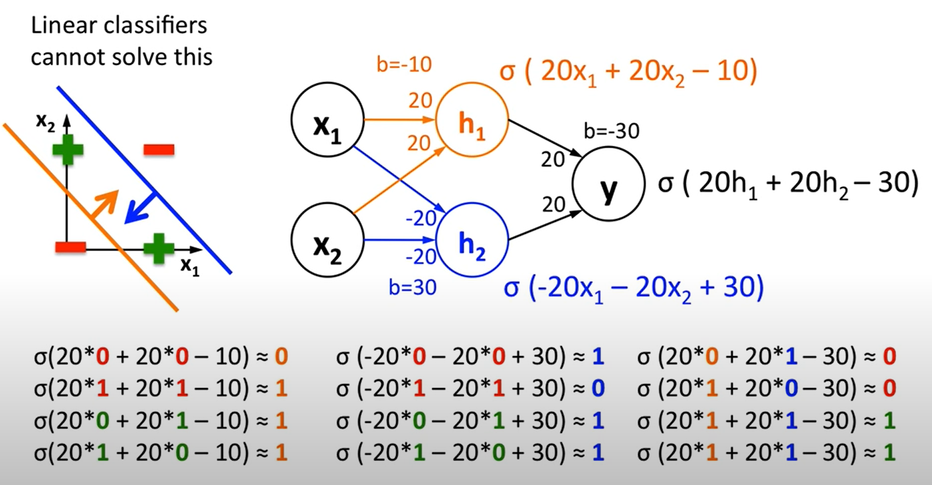
Solving XOR using Multilayer Perceptron

Slide 14
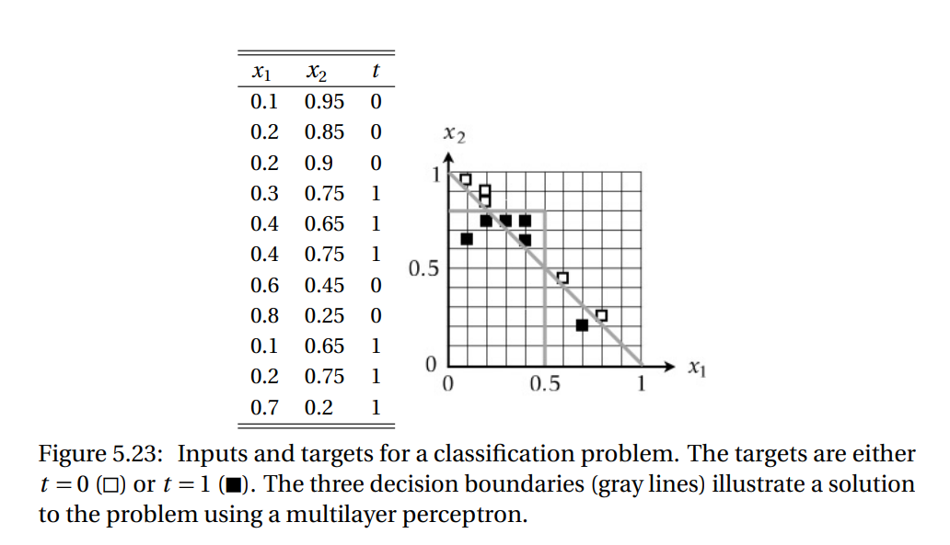
Multilayer Perceptron (MLP)
Machine learning with neural networks An introduction for scientists and engineers, Bernhard Mehlig (page no.100)

Slide 15
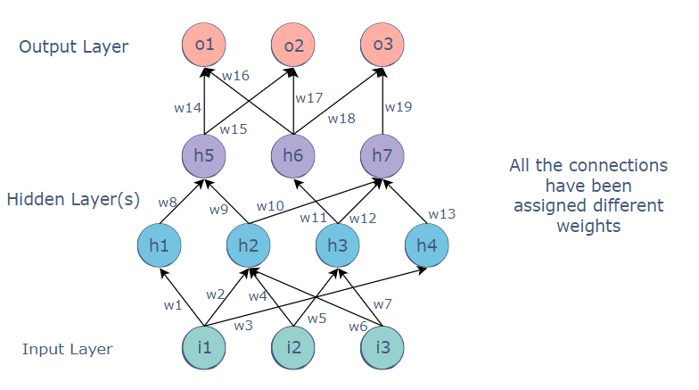
Multilayer Perceptron (MLP)
The MLP is a feedforward neural network, which means that the data is transmitted from the input layer to the output layer in the forward direction.
The value of the h5 node could be:
h5=h1.w8+h2.w9
https://www.educative.io/edpresso/what-is-a-multi-layered-perceptron

Slide 16
Backpropagation in Multilayer Perceptron (MLP)
Backpropagation is a technique used to optimize the weights of an MLP using the outputs as inputs.
In a conventional MLP, random weights are assigned to all the connections. These random weights propagate values through the network to produce the actual output.
Naturally, this output would differ from the expected output. The difference between the two values is called the error.
Backpropagation refers to the process of sending this error back through the network, readjusting the weights automatically so that eventually, the error between the actual and expected output is minimized.
In this way, the output of the current iteration becomes the input and affects the next output. This is repeated until the correct output is produced. The weights at the end of the process would be the ones on which the neural network works correctly.
https://www.educative.io/edpresso/what-is-a-multi-layered-perceptron

Slide 17
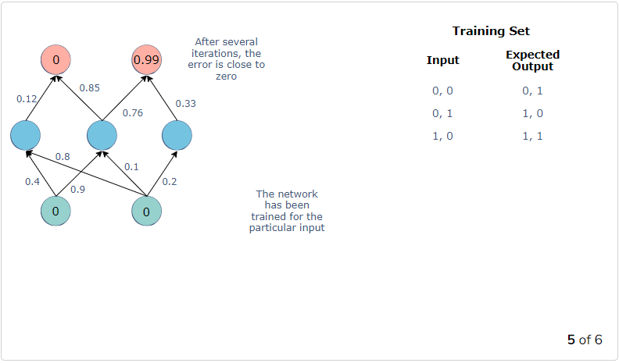
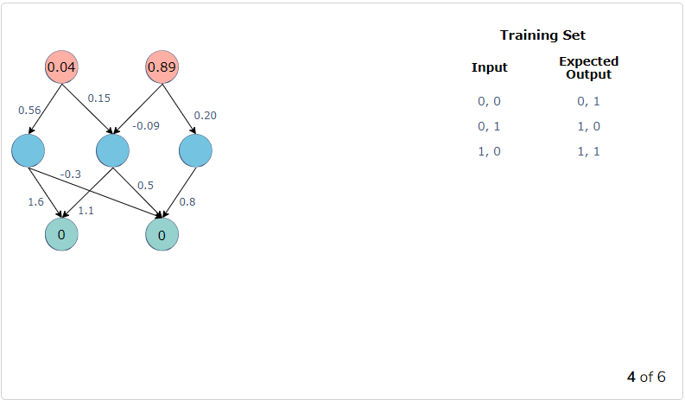
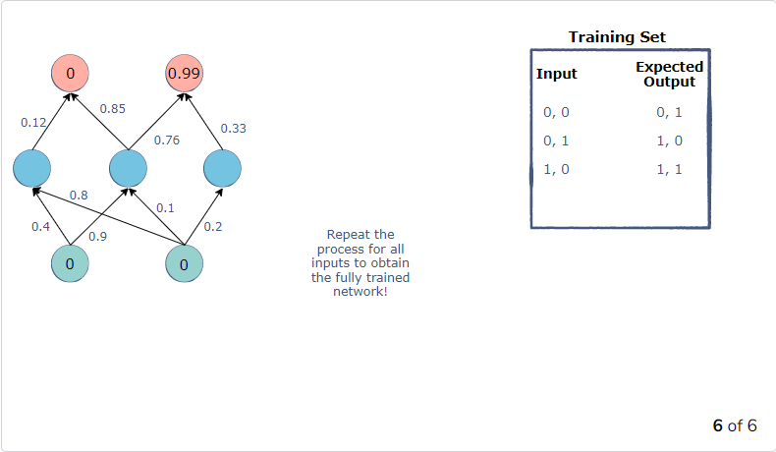
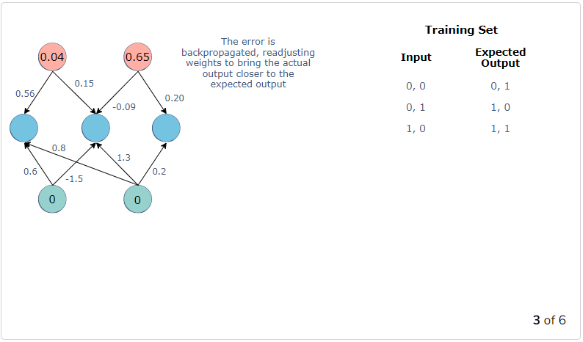
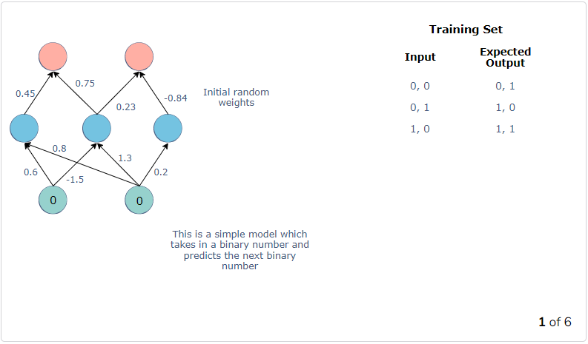
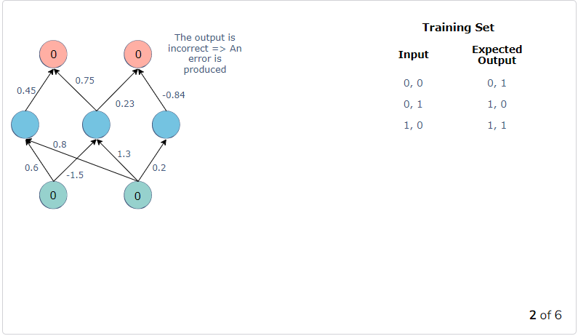
Backpropagation in Multilayer Perceptron (MLP)
How Backpropagation works??
https://www.educative.io/edpresso/what-is-a-multi-layered-perceptron

Slide 18
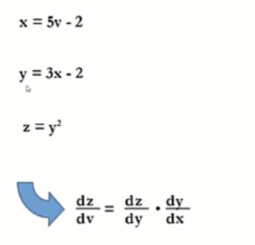
Chain Rule
Chain Rule is covered when you studied Differential Calculus.
The derivatives of energy functions are evaluated the Chain rule.
Machine learning with neural networks An introduction for scientists and engineers, Bernhard Mehlig.

Slide 19
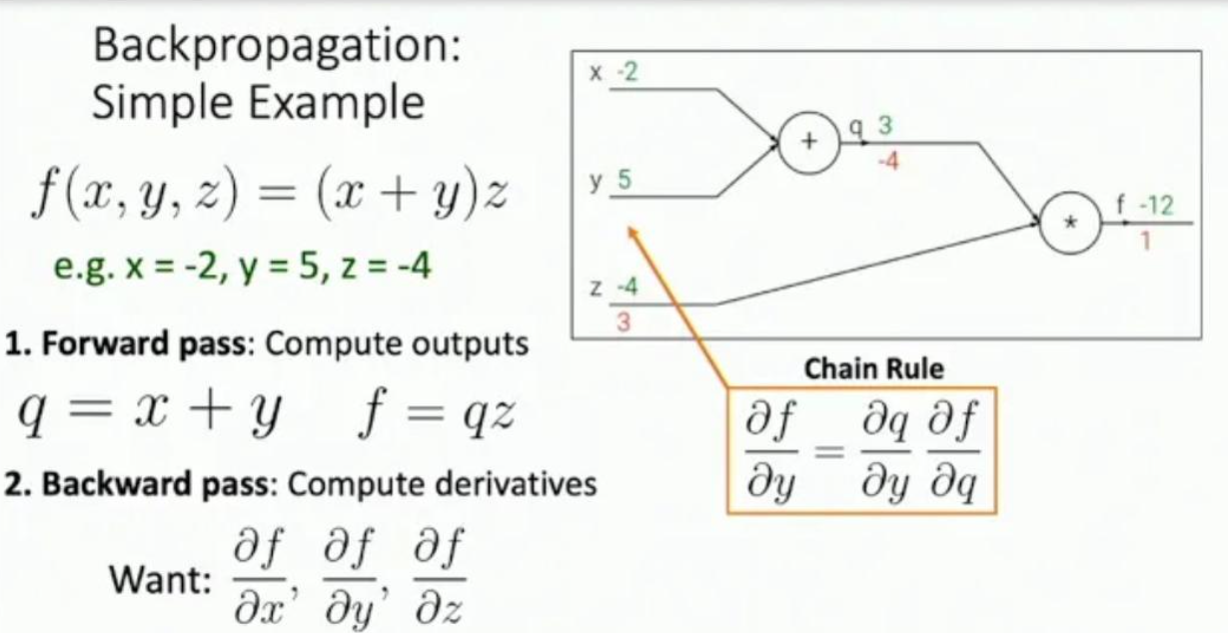
Chain Rule

Slide 20
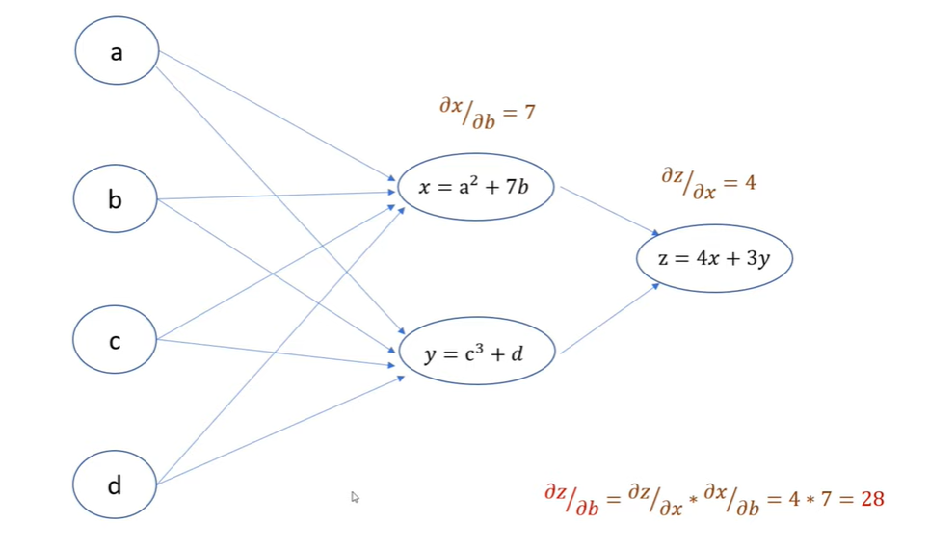
Chain Rule
https://www.youtube.com/watch?v=5ogmEkujoqE

Slide 21
Training Multilayer Perceptron (MLP)
Neural network needs to be trained on dataset
1. Data Preparation
2. Weight Update
3. Prediction

Slide 22
Training MLP- Data Preparation
Data must be numerical, real values.
If categorical data, such as a sex attribute with the values “male” and “female”, then you can convert it to a real-valued representation called a one hot encoding.
one hot encoding can be used on the output variable in classification problems with more than one class.
This would create a binary vector from a single column that would be easy to directly compare to the output of the neuron in the network’s output layer, that as described above, would output one value for each class.
Data Preprocessing
1. Normalization
2. Standardization
3. Scaling

Slide 23
Training MLP- Weight Update Algorithm
Stochastic Gradient Descent
The classical and still preferred training algorithm for neural networks is called stochastic gradient descent.
One row of data is exposed to the network at a time as input and it processes the input upward activating neurons as it goes to finally produce an output value.
The output of the network is compared to the expected output and an error is calculated.
This error is then propagated back through the network, one layer at a time, and the weights are updated according to the amount that they contributed to the error. This is called the backpropagation algorithm.
The process is repeated for all of the examples in your training data.
One round of updating the network for the entire training dataset is called an epoch.
A network may be trained for tens, hundreds or many thousands of epochs.

Slide 24
Training MLP- Weight Update Algorithm
The weights in the network can be updated from the errors calculated for each training example
The errors can be saved up across all of the training examples and the network can be updated at the end.
Datasets are so large and computational efficiencies, the size of the batch, the number of examples the network is shown before an update is often reduced to a small number, such as tens or hundreds of examples.
The amount that weights are updated is controlled by a configuration parameters called the learning rate. It is also called the step size and controls the step or change made to network weight for a given error.
Often small weight sizes are used such as 0.1 or 0.01 or smaller.

Slide 25
Training MLP- Weight Update Algorithm
The update equation can be complemented with additional configuration terms that you can set.
Momentum is a term that incorporates the properties from the previous weight update to allow the weights to continue to change in the same direction even when there is less error being calculated.
Learning Rate Decay is used to decrease the learning rate over epochs to allow the network to make large changes to the weights at the beginning and smaller fine tuning changes later in the training schedule.

Slide 26
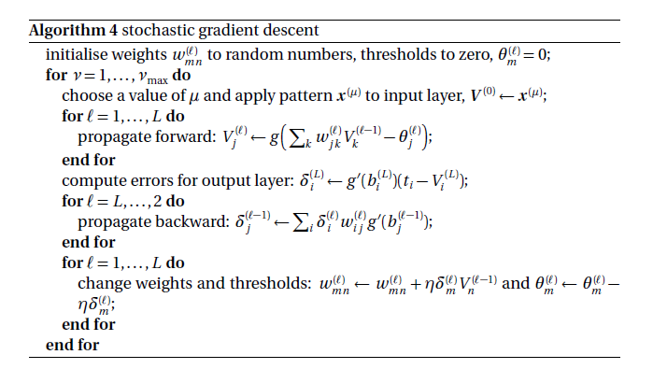
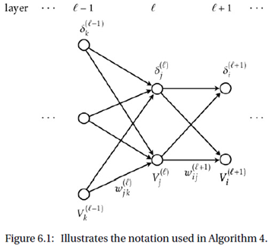
Training MLP- Prediction
Stochastic Gradient Descent
Machine learning with neural networks An introduction for scientists and engineers, Bernhard Mehlig, pg no-106

Slide 27
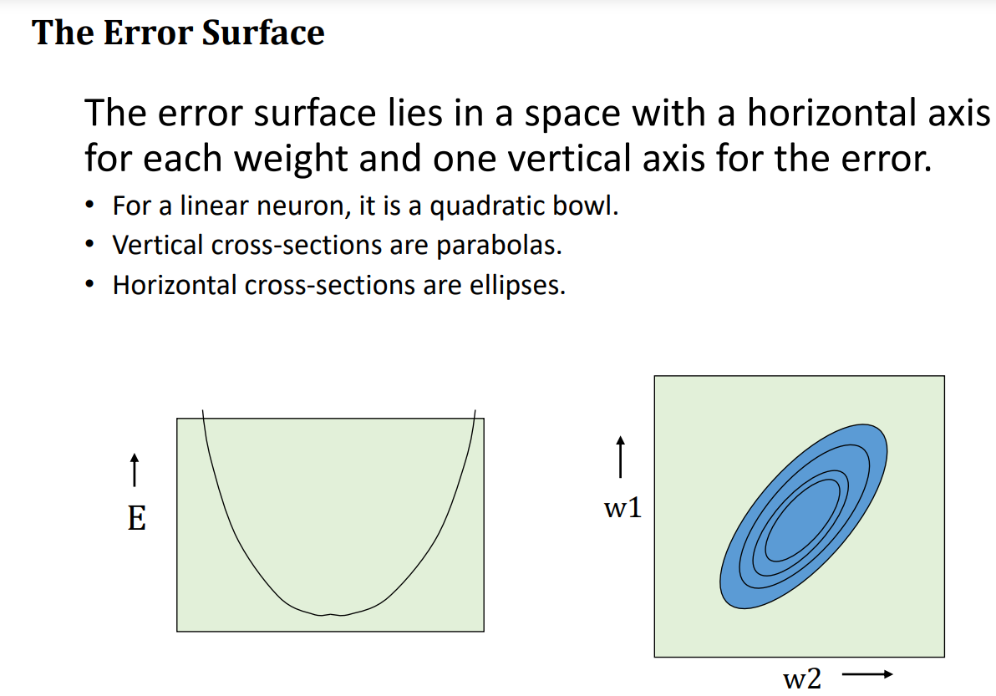
Gradient Descent
Fundamentals of Deep Learning Designing Next-Generation Machine Intelligence AlgorithmsNikhil Buduma, pg no-28

Slide 28
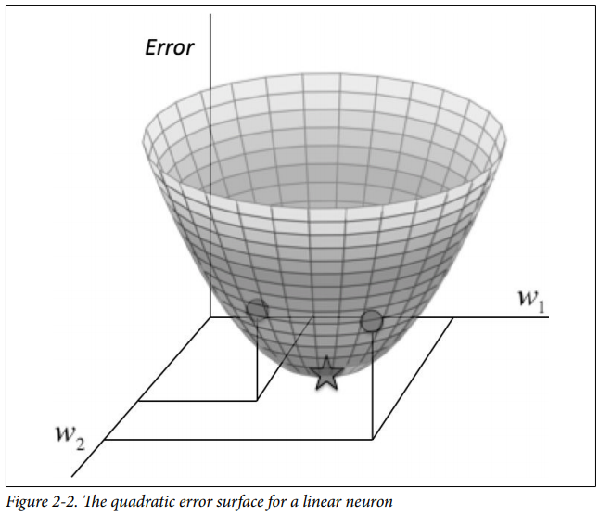
Gradient Descent
How we might minimize the squared error over all of the training examples by simplifying the problem.
E.g Linear neuron only has two inputs (and thus only two weights, w1 and w2 ).
Imagine a three-dimensional space where the horizontal dimensions correspond to the weights w1 and w2 , and the vertical dimension corresponds to the value of the error function E.
In this space, points in the horizontal plane correspond to different settings of the weights, and the height at those points corresponds to the incurred error.
If we consider the errors we make over all possible weights, we get a surface in this three-dimensional space, in particular, a quadratic bowl as shown in Figure.
Fundamentals of Deep Learning Designing Next-Generation Machine Intelligence AlgorithmsNikhil Buduma, pg no-28

Slide 29
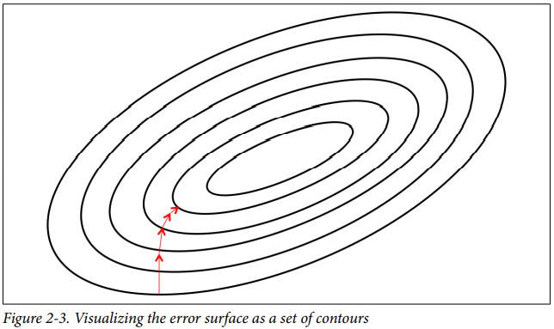
Gradient Descent
Conveniently visualize this surface as a set of elliptical contours, where the minimum error is at the center of the ellipses.
Two-dimensional plane where the dimensions correspond to the two weights.
Contours correspond to settings of w1 and w2 that evaluate to the same value of E.
The closer the contours are to each other, the steeper the slope. In fact, it turns out that the direction of the steepest descent is always perpendicular to the contours.
This direction is expressed as a vector known as the gradient.
Develop a high-level strategy for how to find the values of the weights that minimizes the error function.
Randomly initialize the weights of our network to find ourselves somewhere on the horizontal plane.

Slide 30
Gradient Descent
By evaluating the gradient at current position, we can find the direction of steepest descent, and we can take a step in that direction.
Find a new position that’s closer to the minimum than before.
Reevaluate the direction of steepest descent by taking the gradient at this new position and taking a step in this new direction.
It’s easy to see that, as shown in Figure, following this strategy will eventually get us to the point of minimum error.
This algorithm is known as gradient descent, and it is used to tackle the problem of training individual neurons and the more general challenge of training entire networks.

Slide 31
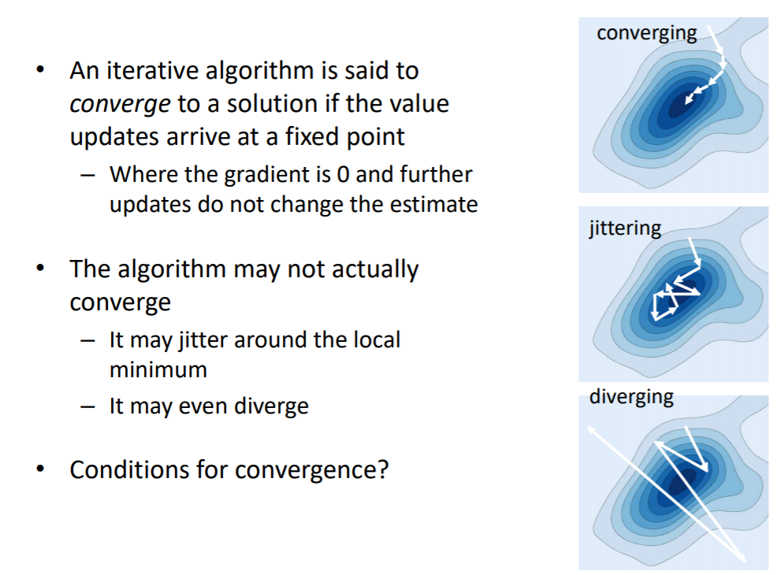
Convergence

Slide 32
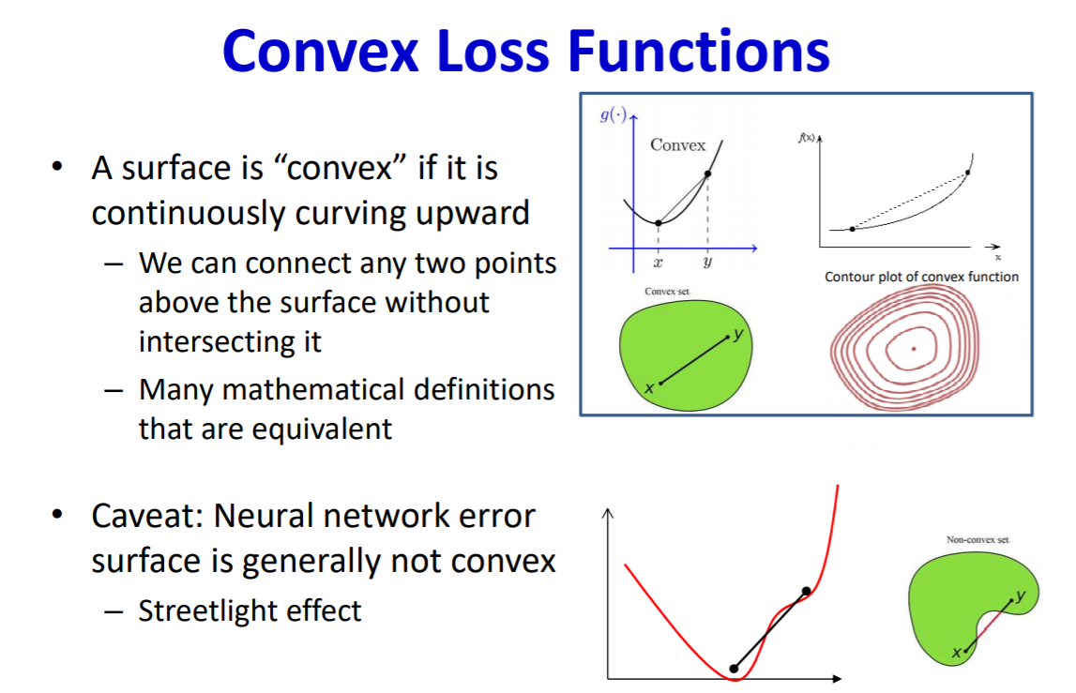
Convergence

Slide 33
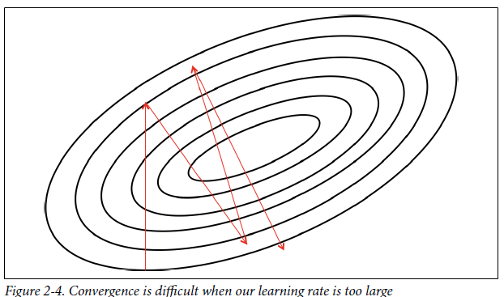
Learning Rate (Hyper-parameter)
In practice, at each step of moving perpendicular to the contour, it needs to determine how far we want to walk before recalculating our new direction.
This distance needs to depend on the steepness of the surface.
Picking the learning rate is a hard problem
if we pick a learning rate that’s too small, we risk taking too long during the training process.
But if we pick a learning rate that’s too big, we’ll mostly likely start diverging away from the minimum.
Fundamentals of Deep Learning Designing Next-Generation Machine Intelligence AlgorithmsNikhil Buduma, pg no-30

Slide 34

Learning Rate
Learning rate selection. Source: https://www.jeremyjordan.me/nn-learning-rate/

Slide 35
Optimization
Optimization is the most essential ingredient in the recipe of machine learning algorithms.
It starts with defining some kind of loss function/cost function and ends with minimizing it using one or the other optimization routine.
The choice of optimization algorithm can make a difference between getting a good accuracy in hours or days.

Slide 36
Optimization
For a deep learning problem, we will usually define a loss function first. Once we have the loss function, we can use an optimization algorithm in attempt to minimize the loss.
In optimization, a loss function is often referred to as the objective function of the optimization problem.
By tradition and convention most optimization algorithms are concerned with minimization. If we ever need to maximize an objective there is a simple solution: just flip the sign on the objective.
The objective function of the optimization algorithm is usually a loss function based on the training dataset, the goal of optimization is to reduce the training error means to reduce the generalization error.
To accomplish the latter we need to pay attention to overfitting in addition to using the optimization algorithm to reduce the training error.
In deep learning, generally, to approach the optimal value, gradient descent is applied to the weights, and optimization is achieved by running many epochs with large datasets.
https://machinelearningmastery.com/tour-of-optimization-algorithms/
https://d2l.ai/chapter_optimization/optimization-intro.html

Slide 37
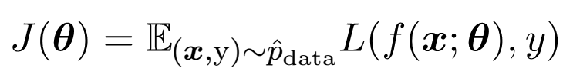
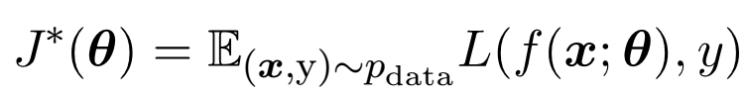
How Learning Differs from Pure Optimization
Goal : Finding the parameters Ɵ that reduce a cost function J(Ɵ).
Typically, the cost function with respect to the training set can be written as:
where L is the per-example loss function,
f(x;θ):the predicted output when the input is x, p’_{data} is the empirical distribution.
In the supervised learning case, y is the target output.
The objective is to minimize the corresponding objective function
https://medium.com/inveterate-learner/deep-learning-book-chapter-8-optimization-for-training-deep-models-part-i-20ae75984cb2

Slide 38
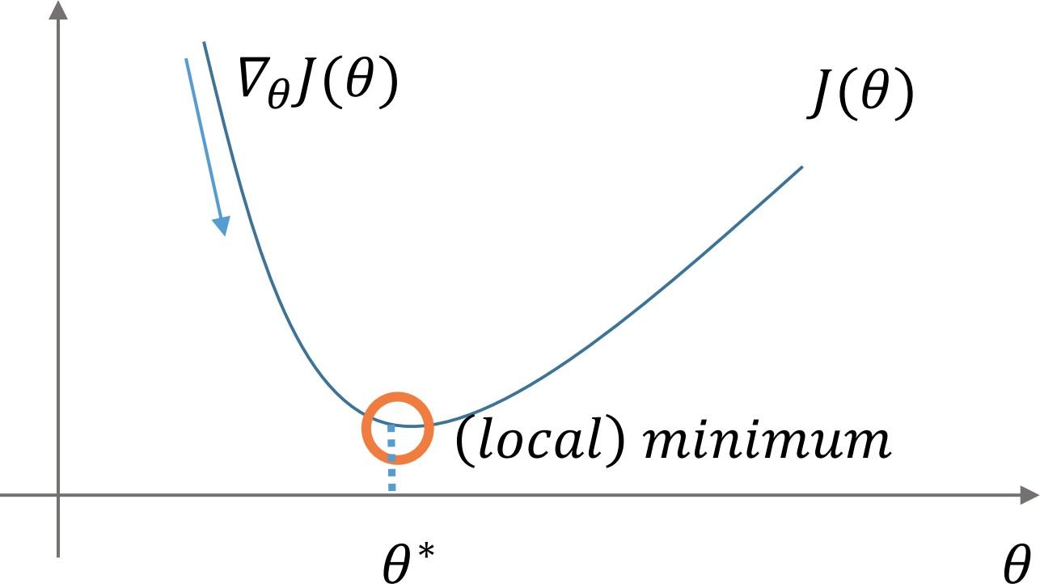
Gradient descent
Most optimization algorithms now are based on Gradient Descent (GD) which requires a derivative calculation and hence, may not work with certain loss functions like the 0–1 loss (as it is not differentiable).
Gradient descent is a way to minimize an objective function J(θ)
θ ∈ Rd : model parameters
η: learning rate
∇θ J(θ): gradient of the objective function with regard to the parameters
Update equation: θ = θ − η · ∇θ J(θ)
Figure: Optimization with gradient descent
https://medium.com/inveterate-learner/deep-learning-book-chapter-8-optimization-for-training-deep-models-part-i-20ae75984cb2

Slide 39
Gradient descent variants
Batch gradient descent
Stochastic gradient descent
Mini-batch gradient descent
1
Gradient Descent algorithm and its variants - GeeksforGeeks

Slide 40
Batch gradient descent
This is a type of gradient descent which processes all the training examples for each iteration of gradient descent.
But if the number of training examples is large, then batch gradient descent is computationally very expensive.
Hence if the number of training examples is large, then batch gradient descent is not preferred. Instead, prefer to use stochastic gradient descent or mini-batch gradient descent.
Pros:
Guaranteed to converge to global minimum for convex error surfaces and to a local minimum for non-convex surfaces.
Cons:
Very slow.
Intractable for datasets that do not fit in memory. No online learning.
1
Gradient Descent algorithm and its variants - GeeksforGeeks

Slide 41
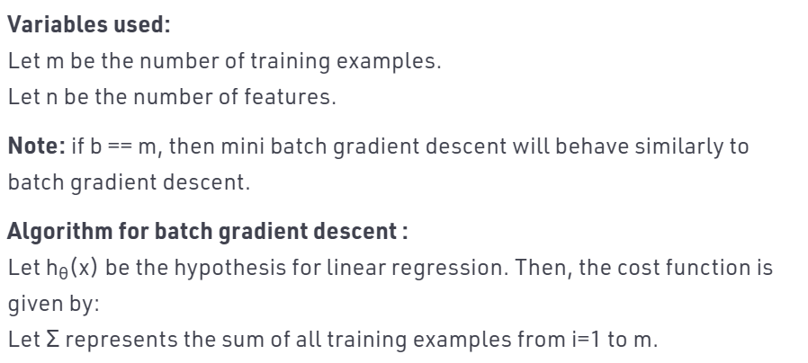
Batch gradient descent
1
Gradient Descent algorithm and its variants - GeeksforGeeks

Slide 42
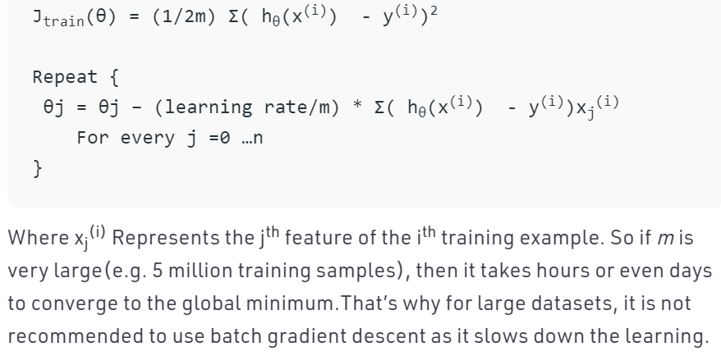
Batch gradient descent Algorithm
1
Gradient Descent algorithm and its variants - GeeksforGeeks

Slide 43
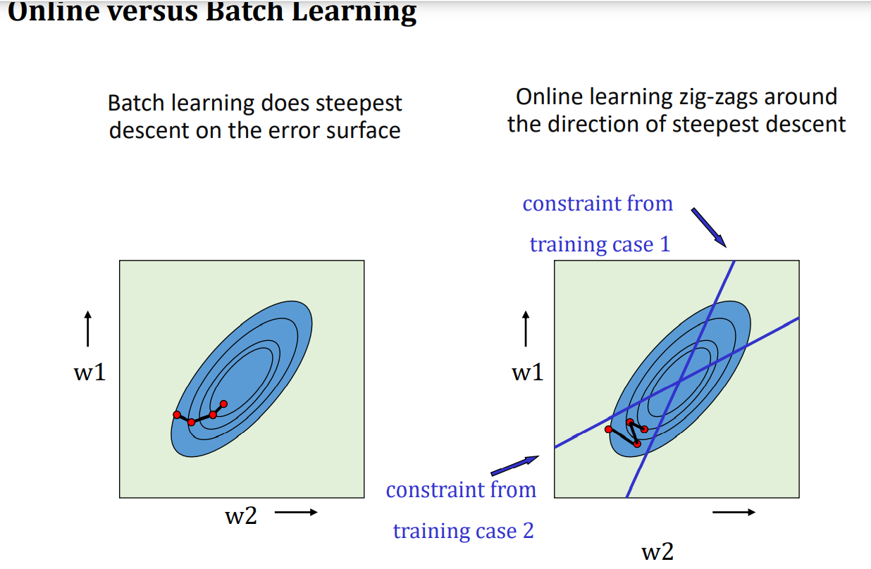
Batch gradient descent
1
Gradient Descent algorithm and its variants - GeeksforGeeks

Slide 44
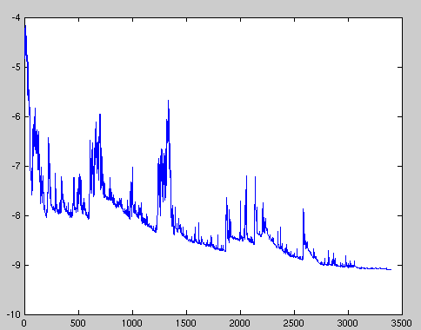
Stochastic gradient descent
This is a type of gradient descent which processes 1 training example per iteration.
Hence, the parameters are being updated even after one iteration in which only a single example has been processed.
Hence this is quite faster than batch gradient descent. But again, when the number of training examples is large, even then it processes only one example which can be additional overhead for the system as the number of iterations will be quite large.
Pros
Much faster than batch gradient descent.
Allows online learning.
Cons
High variance updates.
1
Figure: SGD fluctuation (Source: Wikipedia)
Gradient Descent algorithm and its variants - GeeksforGeeks

Slide 45
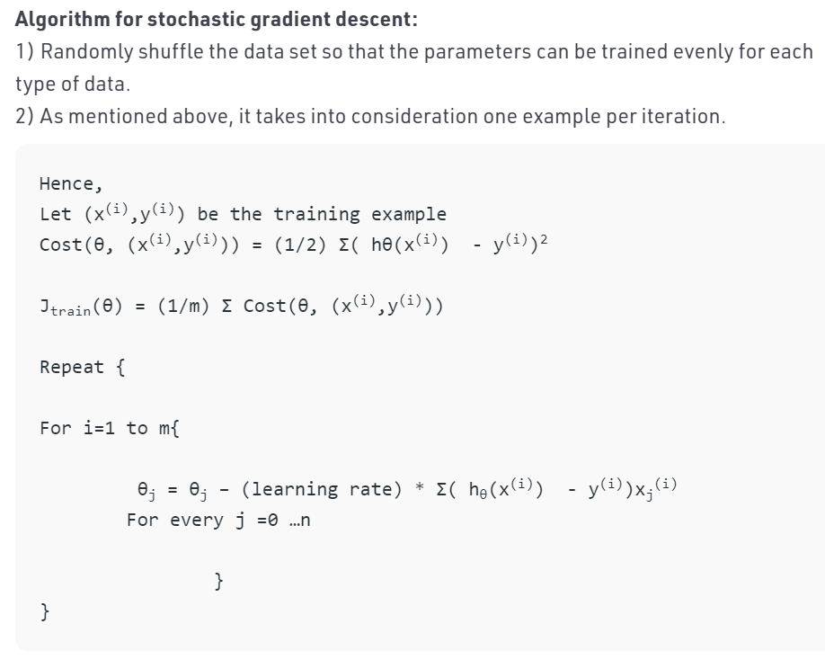
Stochastic gradient descent
1
Gradient Descent algorithm and its variants - GeeksforGeeks

Slide 46
Mini-batch gradient descent
Mini Batch gradient descent: This is a type of gradient descent which works faster than both batch gradient descent and stochastic gradient descent.
Here b examples where b<m are processed per iteration. So even if the number of training examples is large, it is processed in batches of b training examples in one go.
Thus, it works for larger training examples and that too with lesser number of iterations.
Pros
Reduces variance of updates.
Can exploit matrix multiplication primitives.
Cons
Mini-batch size is a hyperparameter. Common sizes are 50-256.
Usually referred to as SGD even when mini-batches are used.

Slide 47
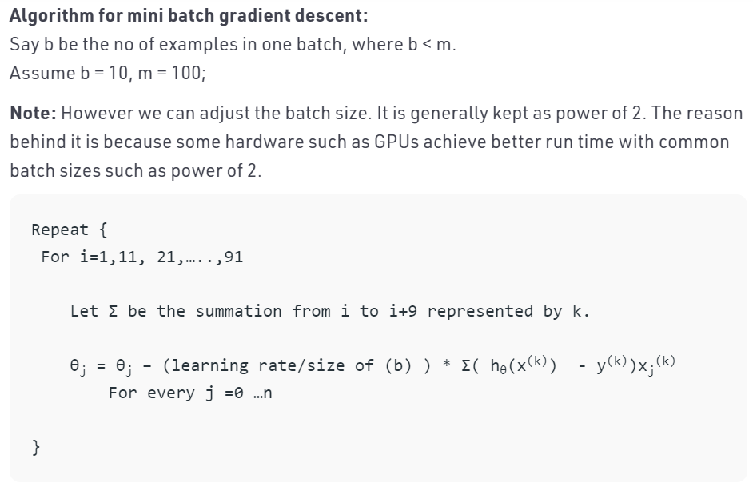
Mini-batch gradient descent
Gradient Descent algorithm and its variants - GeeksforGeeks

Slide 48
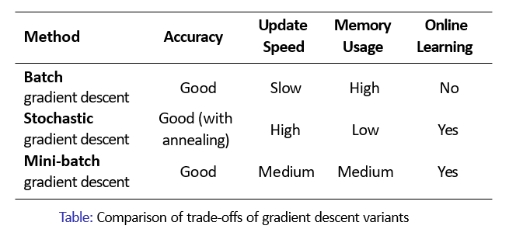
Comparison of trade-offs of gradient descent variants
Gradient Descent algorithm and its variants – GeeksforGeeks
https://medium.com/inveterate-learner/deep-learning-book-chapter-8-optimization-for-training-deep-models-part-i-20ae75984cb2

Slide 49
Optimization Methods
Commonly used optimization methods
Stochastic Gradient Descent with Momentum
AdaGrad
RMSProp
Adam Optimizer
The choice of which algorithm to use, at this point, seems to depend largely on the user’s familiarity with the algorithm (for ease of hyperparameter tuning)
https://medium.com/@minions.k/optimization-techniques-popularly-used-in-deep-learning-3c219ec8e0cc
https://towardsdatascience.com/optimization-algorithms-in-deep-learning-191bfc2737a4
https://www.deeplearningbook.org/contents/optimization.html

Slide 50
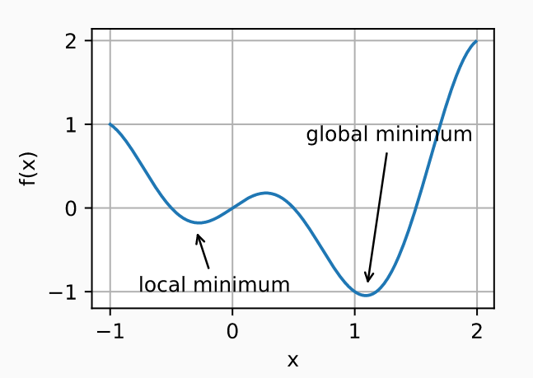
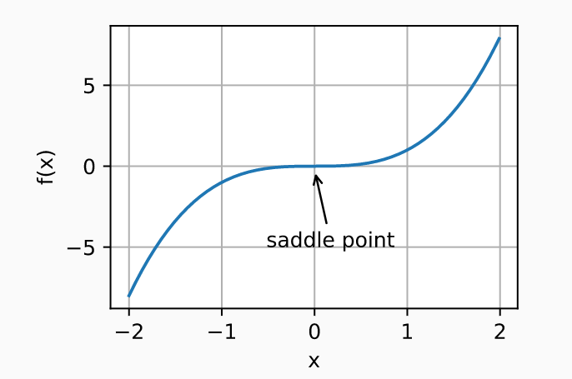
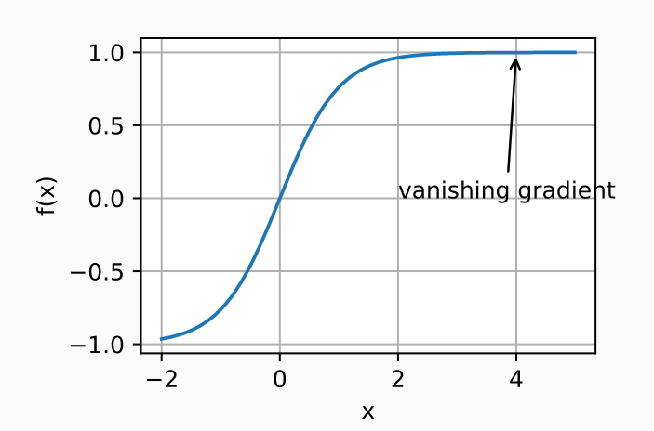
Optimization Methods
Optimization Challenges in Deep Learning
Most vexing challenges are local minima, saddle points(a low part of a ridge between two higher points or peaks), and vanishing gradients
Local Minima saddle points vanishing gradients
The optimization problems may have many local minima.
The problem may have even more saddle points, as generally the problems are not convex.
Vanishing gradients can cause optimization to stall. Often a reparameterization of the problem helps. Good initialization of the parameters can be beneficial, too.
https://d2l.ai/chapter_optimization/optimization-intro.html
Notes:
Vanishing gradient — for very high or very low values of X, there is almost no change to the prediction, causing a vanishing gradient problem. Due to vanishing gradient problem, sigmoid have slow convergence

Slide 51
Optimization Methods
Optimization Challenges in Deep Learning
saddle points
When we optimize neural networks or any high dimensional function, for most of the trajectory we optimize, the critical points(the points where the derivative is zero or close to zero) are saddle points. Saddle points, unlike local minima, are easily escapable

Slide 52
Optimization Methods
Optimization Challenges in Deep Learning
vanishing gradients
When there are more layers in the network, the value of the product of derivative decreases until at some point the partial derivative of the loss function approaches a value close to zero, and the partial derivative vanishes. this is vanishing gradient problem.
With shallow networks, sigmoid function can be used as the small value of gradient does not become an issue.
When it comes to deep networks, the vanishing gradient could have a significant impact on performance. The weights of the network remain unchanged as the derivative vanishes.
During back propagation, a neural network learns by updating its weights and biases to reduce the loss function.
In a network with vanishing gradient, the weights cannot be updated, so the network cannot learn. The performance of the network will decrease as a result.
Notes:
Vanishing gradient — for very high or very low values of X, there is almost no change to the prediction, causing a vanishing gradient problem. Due to vanishing gradient problem, sigmoid have slow convergence

Slide 53
Backpropogation
Feedforward Neural Network
Sources:
https://home.cse.ust.hk/~dekai/4211/lectures/neural_nets/Lecture14
Lecture slides for Chapter 6 of Deep Learning, www.deeplearningbook.org, Ian Goodfellow
Final Year BTECH
Subject : Deep Learning (PE3)

Slide 54
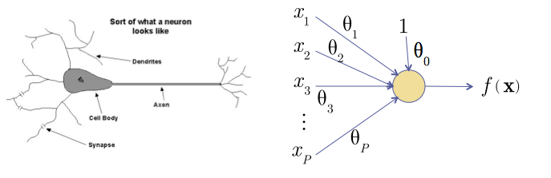
The Neuron Metaphor
Neurons [1]
accept information from multiple inputs
transmit information to other neurons
Multiply inputs by weights along edges
Apply some function to the set of inputs at each node

Slide 55
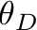
Types of Neurons
Linear Neuron
Logistic Neuron
Perceptron

Slide 56
Multilayer Networks
Cascade Neurons together
The output from one layer is the input to the next
Each Layer has its own sets of weights

Slide 57
Linear Neural Networks
Arrange linear neurons in a multilayer network

Slide 58
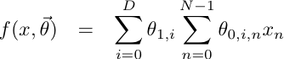
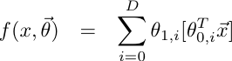
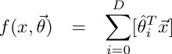
Linear Neural Networks
The product of two linear transformations is itself a linear transformation

Slide 59
Neural Networks
Introduce non-linearities to the network
Non-linearities allow a network to identify complex regions in space

Slide 60
Linear Separability
1-layer cannot handle XOR
More layers can handle more complicated spaces – but require more parameters
Each node splits the feature space with a hyperplane
If the second layer is AND a 2-layer network can represent any convex hull.

Slide 61
Feed-Forward Networks
Predictions are fed forward through the network to classify

Slide 62
Feed-Forward Networks
Predictions are fed forward through the network to classify

Slide 63
Feed-Forward Networks
Predictions are fed forward through the network to classify

Slide 64
Feed-Forward Networks
Predictions are fed forward through the network to classify

Slide 65
Feed-Forward Networks
Predictions are fed forward through the network to classify

Slide 66
Feed-Forward Networks
Predictions are fed forward through the network to classify

Slide 67
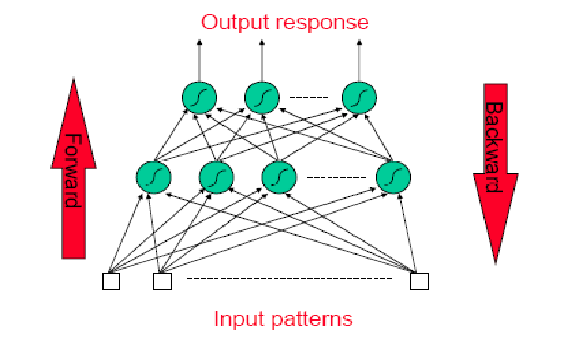
Forward Activity- Backward Error

Slide 68
Backward propagation
Backpropagation has two phases:
Forward pass phase: computes ‘functional signal’, feed forward
Propagation of input pattern signals through network
Backward pass phase: computes ‘error signal’, propagates the error
backwards through network starting at output units
(where the error is the difference between actual and desired output values)

Slide 69
Error Backpropagation
Apply gradient descent on the whole network
Training will proceed from the last layer to the first

Slide 70
Error Backpropagation
Introduce variables over the neural network

Slide 71
Error Backpropagation
Introduce variables over the neural network
Distinguish the input and output of each node
zj

Slide 72
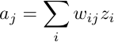
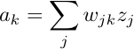
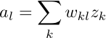
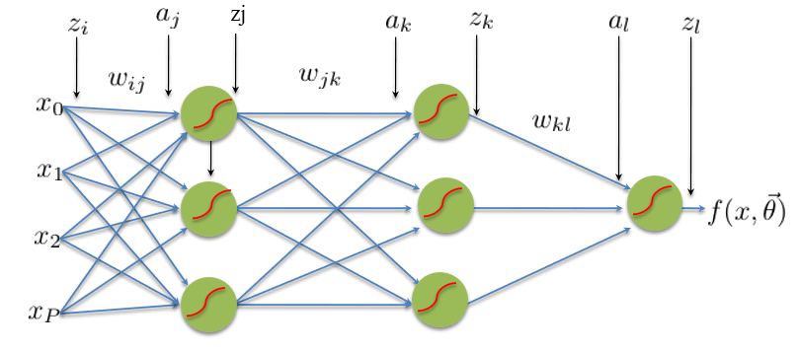
Error Backpropagation

Slide 73
Error Backpropagation
Training: Take the gradient of the last component and iterate backwards

Slide 74

Error Backpropagation
Empirical Risk Function

Slide 75


Error Backpropagation
Optimize last layer weights w_{kl}
Calculus chain rule

Slide 76

Error Backpropagation
Optimize last layer weights w_{kl}
Calculus chain rule

Slide 77

Error Backpropagation
Optimize last layer weights w_{kl}
Calculus chain rule

Slide 78
Error Backpropagation
Optimize last layer weights w_{kl}
Calculus chain rule

Slide 79

Error Backpropagation
Optimize last layer weights w_{kl}
Calculus chain rule

Slide 80


Error Backpropagation
Optimize last hidden weights w_{jk}

Slide 81


Error Backpropagation
Optimize last hidden weights w_{jk}
Multivariate chain rule

Slide 82

Error Backpropagation
Optimize last hidden weights w_{jk}
Multivariate chain rule

Slide 83

Error Backpropagation
Optimize last hidden weights w_{jk}
Multivariate chain rule

Slide 84
Error Backpropagation
Repeat for all previous layers

Slide 85

Error Backpropagation
Now that we have well defined gradients for each parameter, update using Gradient Descent

Slide 86
Error Back-propagation
Error backpropagation unravels the multivariate chain rule and solves the gradient for each partial component separately.
The target values for each layer come from the next layer.
This feeds the errors back along the network.

